Slide 1

Indian
Unicorns Of
2021

Slide 2
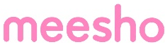

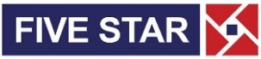



Apr. 05
Apr. 06
Mar. 27
Jan. 15
Feb. 25
Feb. 24

Slide 3







Apr. 08
Apr. 07
Apr. 07
Apr. 08
May. 17
Apr. 20
Apr. 28

Slide 4






July 31
Aug 04
July 28
July 22
May. 24
June 16

Slide 5
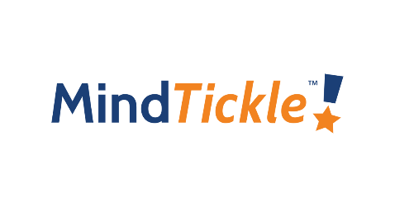





Aug 09
Aug 10
Aug 05
Aug 12
Aug 20
Aug 23
Sep 16

Slide 6
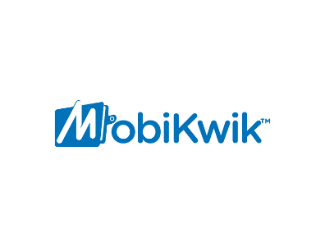






Oct 13
Oct 13
Oct 07
Sep 29
Oct 06
Sep 16
Oct 05

Slide 7

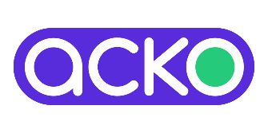


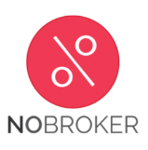


Nov 09
Nov 10
Oct 28
Nov 16
Nov 23
Nov 24
Nov 26

Slide 8




Dec 29
Dec 28
Nov 29
Dec 08

Slide 9

STARTUP | ABOUT | UNICORN DATE | FUNDING | INVESTORS
 | Digit is a general insurance company started by Kamesh Goyal and backed by the Fairfax Group. Its services include car insurance, travel insurance, home insurance, commercial vehicle insurance, and shop insurance. The company is driven by a mission to reimagine products and redesign price processes. | Jan. 15, 2021 | USD 244.5M | Fairfax Financial Holdings, TVS Capital Funds, A91 Partners and Faering Capital
 | Innovaccer is a healthcare data activation company focused on delivering effective healthcare through the use of pioneering analytics and transparent data. Innovaccer aims to make full use of all the data healthcare has worked so hard to collect. | Feb. 24, 2021 | USD 229.1M | Tiger Global Management, Steadview Capital, Dragoneer, B Capital Group, Mubadala Capital, M12 (Microsoft's Venture Fund) and OMERS Growth Equity
 | Infra.Market develops an online procurement marketplace intended to serve the real estate and construction materials industry. Its centralized platform aggregates clients' demands, matching them with its supply chain along with affordable credit options and efficient delivery tracking facility, providing clients with fair pricing and enhanced technology experience. | Feb. 25, 2021 | USD 161.5M | Evolvence India Fund, Sistema Asia Fund, Foundamental, Accel, Tiger Global and Nexus

Slide 10
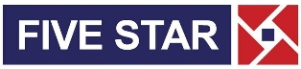
STARTUP | ABOUT | UNICORN DATE | FUNDING | INVESTORS
 | Five Star provides Small Business loans and Small Mortgage loans to eligible borrowers to meet their business and personal needs, after due underwriting of their cashflows and backed by the collateral of their house property. Five-Star is a Registered Non Banking Finance Company (NBFC) with Reserve Bank of India (RBI). | Mar. 27, 2021 | USD 456.1M | Sequoia Capital, KKR, TVS Capital, Norwest Venture Partners, Morgan Stanley Private Equity, Matrix and TPG Capital
 | Meesho operates as an online reselling platform that enables anyone to start a business without investment. Meesho is a business platform trusted by more than 2.6 million resellers across India. | Apr. 05, 2021 | USD 515.2M | Facebook, Softbank Vision Fund, Shunwei Capital, Knollwood Investment Advisory, Prosus Ventures, Venture Highway, Elevation Capital, Sequoia Capital and DST Parnters
 | CRED is a members-only credit card management and bill payments platform that rewards users every time they pay their credit card bills. The fintech startup operates an app that rewards customers for paying their credit card bills on time and gives them access to a range of additional services such as credit and a premium catalog of products from high-end brands. | Apr. 06, 2021 | USD 471.2M | Falcon Edge Capital, Coatue Management LLP, Insight Partners, DST Global, RTP Global, Tiger Global, Greenoaks Capital, Dragoneer Investment Group and Sofina

Slide 11

STARTUP | ABOUT | UNICORN DATE | FUNDING | INVESTORS
 | PharmEasy is a health tech startup offering services such as teleconsultation, medicine deliveries, and diagnostic test sample collections. It also operates an online pharmacy that helps patients connect with local pharmacy stores and diagnostic centers in order to fulfill their extensive medical needs. . | Apr. 07, 2021 | USD 651.5M | Prosus Ventures, TPG Growth, Temasek, CDPQ, LGT Lightrock, Eight Roads, F-Prime Capital, and Think Investments
 | Groww is an investment platform that offers a new way of investing money with stockbroking and direct mutual funds. | Apr. 07, 2021 | USD 142.3M | Tiger Global Management, Sequoia Capital India, Ribbit Capital, YC Continuity, Propel Venture Partners, Insignia Venture Partners, America’s Lightbridge Partners and Kairos fund
 | ShareChat is an Indian social media startup. It offers the content consumption and sharing platform only in Indian vernacular languages to cater to over 1.17 billion wireless network users of India. It is available in 15 Indian languages. | Apr. 08, 2021 | USD 824.8M | Tiger Global, Snap, Twitter Ventures, Lightspeed Venture Partner, Saif Parnters, Xiaomi, SAIF Capital, India Quotient and Morningside Venture Capital

Slide 12

STARTUP | ABOUT | UNICORN DATE | FUNDING | INVESTORS
 | Gupshup provides an enterprise messaging platform. It provides a messaging app and tool for the developers to build, test, deploy, monitor, and track bots across various platforms. It helps businesses to engage with the customers using various channels that include SMS, Whatsapp, Facebook, Twitter, Voice, Amazon Alexa, Team chat, and Google Assistant. | Apr. 08, 2021 | USD 144.1M | Tiger Global, CRV, Globespan Capital Partners, Helion Venture Partners, Tenaya Partners and Lloyd George Management
 | Chargebee offers subscription and recurring billing system for subscription-based SaaS and eCommerce businesses. It is built with a focus on delivering the best experience to provide a seamless and flexible recurring billing experience to customers and manage customer subscriptions. | Apr. 20, 2021 | USD 218.2M | Sapphire Ventures, Tiger Global Management, Steadview Capital, Insight Partner and Accel
 | Urban provides a marketplace for freelance labor. It offers a variety of home services to consumers, including beauty treatments, haircuts, deep cleaning, plumbing, carpentry, and appliance repairs. The platform helps customers book reliable home services and it aims to help millions of service professionals across the world to deliver services at home. | Apr. 28, 2021 | USD 445.9M | DF International Partners, Wellington Management, Tiger Global, Steadview Capital, Prosus Ventures, Dragoneer Investment Group and Vy Capital

Slide 13
STARTUP | ABOUT | UNICORN DATE | FUNDING | INVESTORS
 | Moglix is an e-commerce platform for industrial tools and equipment. The company is engaged in marketing industrial supplies, in particular, MRO, Safety, Electrical & Lighting, Cleaning & Laundry Supplies, Office Supplies, Tools, and many more industry essentials. | May 17, 2021 | USD 222.2M | Falcon Edge Capital, Accel, Sequoia Capital, Tiger Global Management, Ratan Tata, Innoven Capital, Composite Capital Management, Harvard Management Company and Jungle Ventures
 | Zeta is a modern banking tech company providing Modern Core and Processing for FIs and Embeddable Banking for fintechs and distributors. | May 24, 2021 | USD 310M | Sodexo and Softbank Vision Fund
 | BrowserStack is a cloud-based cross-browser testing solutions provider. The product offers a cloud platform where developers, testers, and designers can test their web applications. It also offers local testing that allows users to test their internal servers. | June 16, 2021 | USD 250M | Insight Partners, Accel and Bond

Slide 14
STARTUP | ABOUT | UNICORN DATE | FUNDING | INVESTORS
 | BlackBuck is a web & AI-based marketplace for booking freight transportation. Through its web-based platforms, load providers can post loads and find carriers, make bookings, and track shipments using GPS. | July 22, 2021 | USD 67M | Tribe Capital, IFC Emerging Asia Fund, VEF, Wellington Management, Sands Capital, and International Finance Corporation
 | Droom is an AI and data science driven online transactional platform, which offers 21st century experience in buying & selling used & new automobiles in India & other emerging markets. | July 28, 2021 | USD 200M | Existing and new investors, including 57 Stars and Seven Train Ventures
 | OfBusiness serves as a single-window for SMEs in the manufacturing and infrastructure space to provide unsecured credit lines as an alternate to financing. SMEs can use this limit for cost-effective procurement of raw material which the platform aggregates, passing the aggregation benefits to the SMEs. | July 31, 2021 | USD 160M | Softbank Vision Fund II, Falcon Edge Capital and Matrix Partners

Slide 15


STARTUP | ABOUT | UNICORN DATE | FUNDING | INVESTORS
 | BharatPe is an offline acquirer of merchants, providing a QR code for UPI payments, POS machine for card acceptance, and loans to small merchants. | Aug 04, 2021 | USD 270M | Tiger Global, Dragoneer Investment Group, Steadfast Capital, Coatue Management, Insight Partners, Sequoia Growth, Ribbit Capital, and Amplo
 | MindTickle is a software company that offers sales readiness and enablement tools for businesses. | Aug 05, 2021 | USD 100M | Softbank Vision Fund II, Norwest Venture Partners, Canaan, NewView Capital, and Qualcomm Ventures
 | UpGrad is an online higher education platform providing programs in Data Science, Technology, Management, and Law, to students, working professionals and enterprises. | Aug 09, 2021 | USD 185M | Temasek, World Bank’s International Finance Corporation and IIFL

Slide 16
STARTUP | ABOUT | UNICORN DATE | FUNDING | INVESTORS
 | CoinDCX is a cryptocurrency exchange platform. It allows users to buy, sell, and trade digital currencies through encrypted networks. | Aug 10, 2021 | USD 90M | B Capital, Coinbase Ventures, Polychain Capital, Block.one, Jump Capital and others
 | Eruditus collaborates with top universities to make executive education accessible globally. Eruditus has partnered with more than 30 universities to date, including MIT, Columbia, Harvard, Cambridge, INSEAD, Wharton, UC Berkeley, INCAE, IIT, IIM, NUS, and HKUST, launching more than 100 courses and serving students from more than 80 countries. | Aug 12, 2021 | USD 650M | Accel, SoftBank Vision Fund 2, The Chan Zuckerberg Initiative, Sequoia India, Bertelsmann, Prosus, and Leeds Illuminate
 | Zetwerk is an end-to-end manufacturing supply chain solutions provider. The online marketplace connects large manufacturing companies with vendors and suppliers for customized products that are used as components of industrial machines and equipment. | Aug 20, 2021 | USD 150M | D1 Capital Partners, Green Oaks, Lightspeed, Avenir, Sequoia Capital, Accel and angel investors

Slide 17
STARTUP | ABOUT | UNICORN DATE | FUNDING | INVESTORS
 | Grofers is a low-price online supermarket that gets products across categories like grocery, beauty, and wellness, household care, baby care, pet care delivered to your doorstep. | Aug 23, 2021 | USD 662.4M | Tiger Global Management, KTB Ventures, Softbank Vision Fund, Sequoia Capital India, Bennett Coleman and Co Ltd. and Abu Dhabi Capital Group
 | Mobile Premier League (MPL), is India’s largest eSports and mobile gaming platform, with over 70+ games on its app on iOS and Android. MPL has also expanded to Indonesia and the US and is growing exponentially, with over 90 million users across the globe! | Sep 16, 2021 | USD 150M | Legatum Capital, Sequoia, SIG, RTP Global, Go-Ventures, Moore Strategic Ventures, Play Ventures, Base Partners, Telstra Ventures and Founders Circle Capital
 | Apna is a professional networking and jobs platform that helps blue and gray-collar workers find communities and land jobs. The app is currently serving in 28 cities across India. | Sep 16, 2021 | USD 100M | Tiger Global, Owl Ventures, Maverick Ventures, GSV Ventures, Sequoia Capital India and Insight Partners

Slide 18
STARTUP | ABOUT | UNICORN DATE | FUNDING | INVESTORS
 | Vedantu is an e-learning company that features an online platform that features real-time personalized learning. It provides a software platform connects tutors and student which provides real-time one to one teaching to students online. | Sep 29, 2021 | USD 100M | ABC World Asia, Coatue, Tiger Global, GGV Capital, and WestBridge among others
 | Licious is an online meat and seafood ordering startup that follows an end-to-end business. | Oct 05, 2021 | USD 52M | IIFL AMC’s Late Stage Tech Fund
 | CoinSwitch Kuber is a cryptocurrency exchange platform allowing its users to buy and sell cryptocurrencies. | Oct 06, 2021 | USD 260M | a16z (Andreesen Horowitz) and Coinbase Ventures.

Slide 19
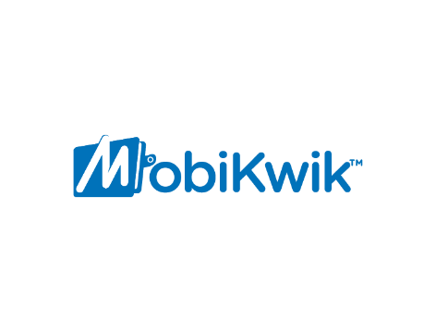
STARTUP | ABOUT | UNICORN DATE | FUNDING | INVESTORS
 | Rebel Foods, formerly known as Faasos, is the world's largest chain of online restaurants. Today, they operate 15+ own brands such as Behrouz Biryani, Ovenstory Pizza, Faasos, Mandarin Oak, Sweet Truth and more. | Oct 07, 2021 | USD 175M | Qatar Investment Authority, Coatue and Evolvence India
 | CarDekho group operates auto sites such as CarDekho.com, Gaadi.com, ZigWheels.com and BikeDekho.com. Its fintech platform is the fourth largest used car retail loan originator in India, behind HDFC Bank, ICICI Bank and Mahindra Finance. | Oct 13, 2021 | USD 250M | LeapFrog Investments, Canyon Partners, Mirae Asset, Franklin Templeton, Harbor Spring Capital, Sequoia Capital India and Sunley House
 | MobiKwik is India’s leading fintech platform, operating businesses in consumer payments, payment gateway, and financial services. | Oct 13, 2021 | - | Former Blackstone India head Mathew Cyriac

Slide 20
STARTUP | ABOUT | UNICORN DATE | FUNDING | INVESTORS
 | Acko provides offerings in auto, health and travel insurance segments where it has partnered with the likes of cab-aggregator Ola and Amazon for bite-sized insurance covers available through their respective apps. | Oct 28, 2021 | USD 255M | General Atlantic, Multiples Private Equity, CPPIB, Lightspeed Growth, Intact Ventures and Munich Re Ventures.
 | The Good Glamm Group comprises a portfolio of proprietary beauty and personal care brands that are powered by a digital ecosystem of content, community and creator assets. | Nov 09, 2021 | USD 150M | Prosus Ventures, Warburg Pincus, Alteria Capital, L’Occitane, Bessemer Venture Partners, Amazon, Ascent Capital and the Mankekar Family Office
 | Cure.fit is a health and fitness company offering digital and offline experiences across fitness, nutrition, and mental well-being. | Nov 10, 2021 | USD 50M | Zomato

Slide 21
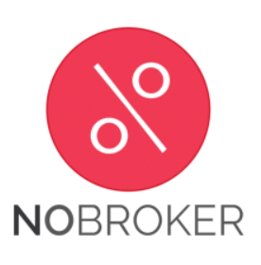
STARTUP | ABOUT | UNICORN DATE | FUNDING | INVESTORS
 | Mensa Brands is an Indian startup that acquires direct-to-consumer brands and helps them scale within the home market and overseas. The startup operates in three categories — apparel, beauty and personal care, and home. | Nov 16, 2021 | USD 135M | Falcon Edge Capital, Tiger Global, Norwest Venture Partners and Accel
 | NoBroker.com enables users to not only look for brokerage-free houses on rent, but helps them move, get home loans, avail cleaning and home painting services, pay rent, and access legal services, among others. | Nov 23, 2021 | USD 210M | General Atlantic, Tiger Global and Moore Strategic Ventures
 | Spinny is a used car retailing platform. It operates across the entire value chain of pre-owned cars, embedding superior technology and processes to deliver a premium experience to customers. | Nov 24, 2021 | USD 248M | Tiger Global, Abu Dhabi Growth Fund and Avenir Growth

Slide 22
STARTUP | ABOUT | UNICORN DATE | FUNDING | INVESTORS
 | Upstox is a fin-tech company to allow innovative investment options for its users. Along with allowing people to buy and sell stocks and other financial instruments on its platform, Upstox offers advisory services. | Nov 26, 2021 | USD 25M | Tiger Global
 | Slice is a fintech company based in India to pay bills, manage expenses, and unlock instant rewards. It is focused on new-age millennials and Gen Z, with an average age of 27, who have largely been refused credit cards by large banks due to inadequate credit scoring around this demographic. | Nov 29, 2021 | USD 220M | Tiger Global Management, Insight Partners, Sunley House Capital, Moore Strategic Ventures, Anfa, Gunosy, 8i and Blume Ventures
 | Pristyn Care is Health Care Startup that is disrupting Elective Surgery Procedures. Pristyn is looking to build an ecosystem to deliver surgical care. Besides surgeries, the platform focuses on doctor’s consultations, hospital admissions and pre- as well as post-surgical follow-ups. | Dec 08, 2021 | USD 100M | Sequoia Capital, Tiger Global and others

Slide 23
STARTUP | ABOUT | UNICORN DATE | FUNDING | INVESTORS
 | Launched in 2021, GlobalBees which is headed by Nitin Agarwal as the CEO, invests in and acquires seller business on Amazon India, Flipkart and other ecommerce marketplaces. As of date, GlobalBees has acquired eight D2C brands including The Better Home, andME, Prolixr, Absorbia, among others. | Dec 28, 2021 | USD 111M | FirstCry, SoftBank, Premji Invest, Chiratae Ventures, Trifecta Capital, Steadview Capital and Lyon Investment Group
 | Launched in 2016, Mamaearth is one of the fastest-growing brands in India’s FMCG sector. It has grown to 140-odd SKUs in baby care, skincare, and haircare segments, and has served more than five million consumers across 500 cities. | Dec 29, 2021 | USD 37.5M | Sequoia Capital

Slide 24

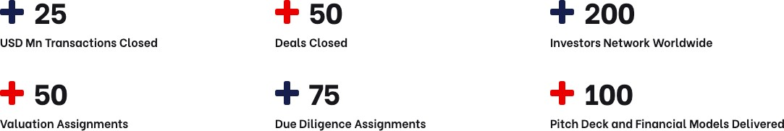


About Us
Nucleus AAR Advisors LLP is a business consulting firm providing specialized services in the field of Investment Banking, Deal Transaction Advisory, Corporate Advisory, International Taxation, Audit & Assurance. We partner entrepreneurs in their critical decision making by providing them various analysis customized as per their requirement. We also help in the effective implementation of decisions and its subsequent monitoring as well.
Team Nucleus is comprised of people from Big4s and reputed consulting firms with combined experience of 30+ years.
Team is distinguished by their functional and technical expertise combined with their hands-on experience, thereby ensuring that our clients receive the most professional service.
Click to Follow On
W : www.nucleusadvisors.in
E : info@nucleusadvisors.in

